Slide 1
Wind energy

Slide 2




About us
Fawn Zou
Li Gao
Steve Darby
Vien Vo

Slide 3
Questions
Requirements for suitable location for wind farms.
Which states have most locations suitable for wind farms?
Where to build wind farm?
Which states benefit most from wind energy?

Slide 4
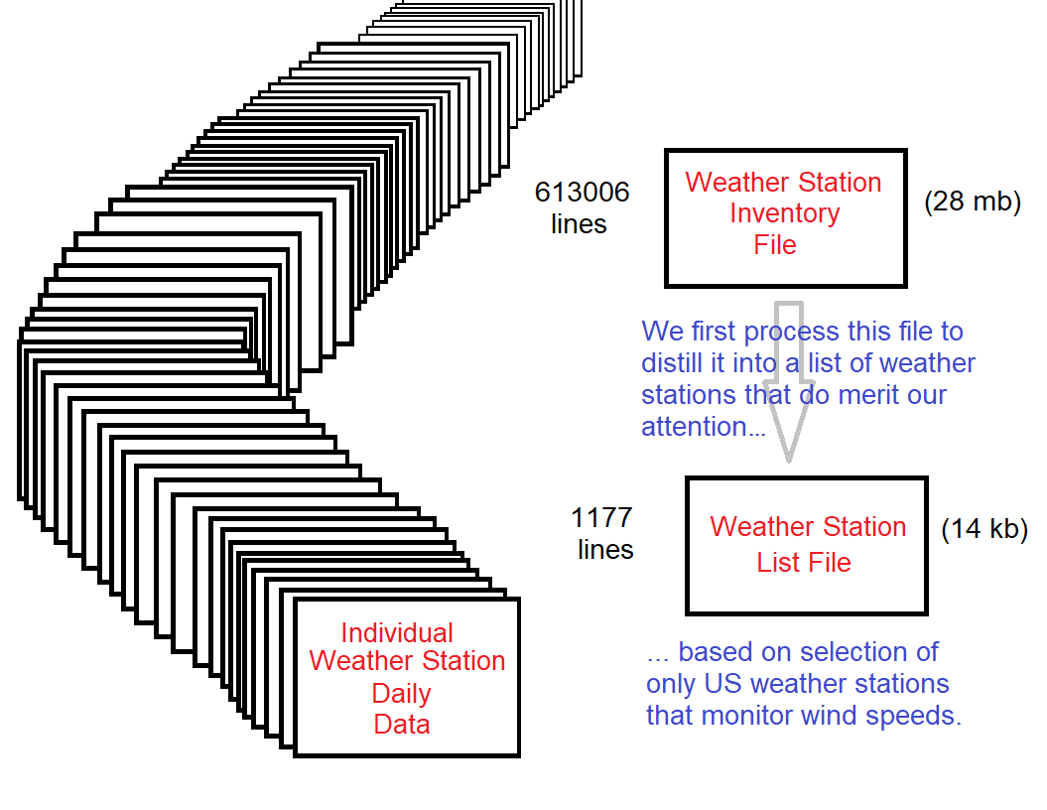
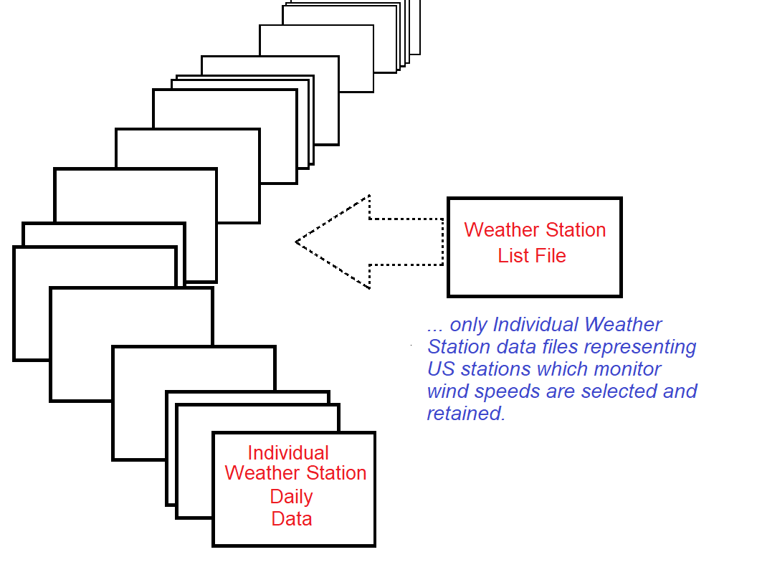
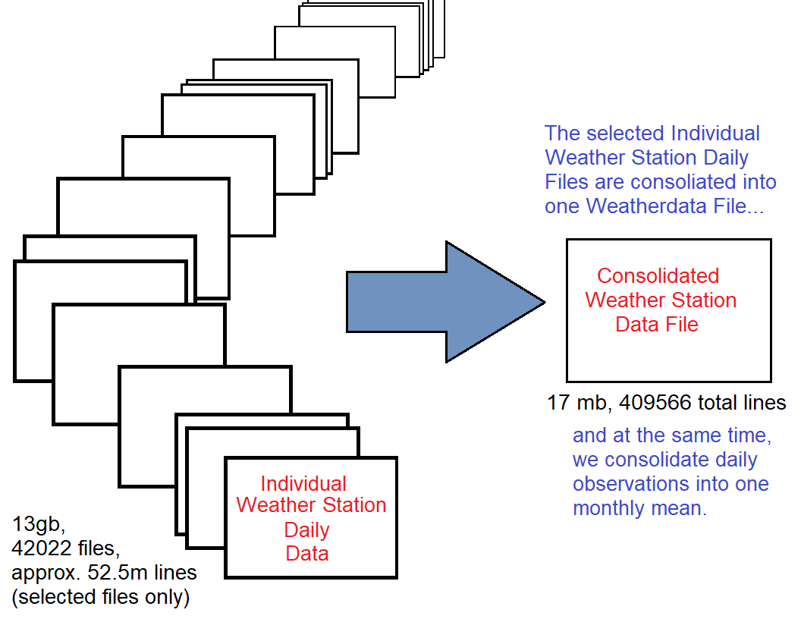
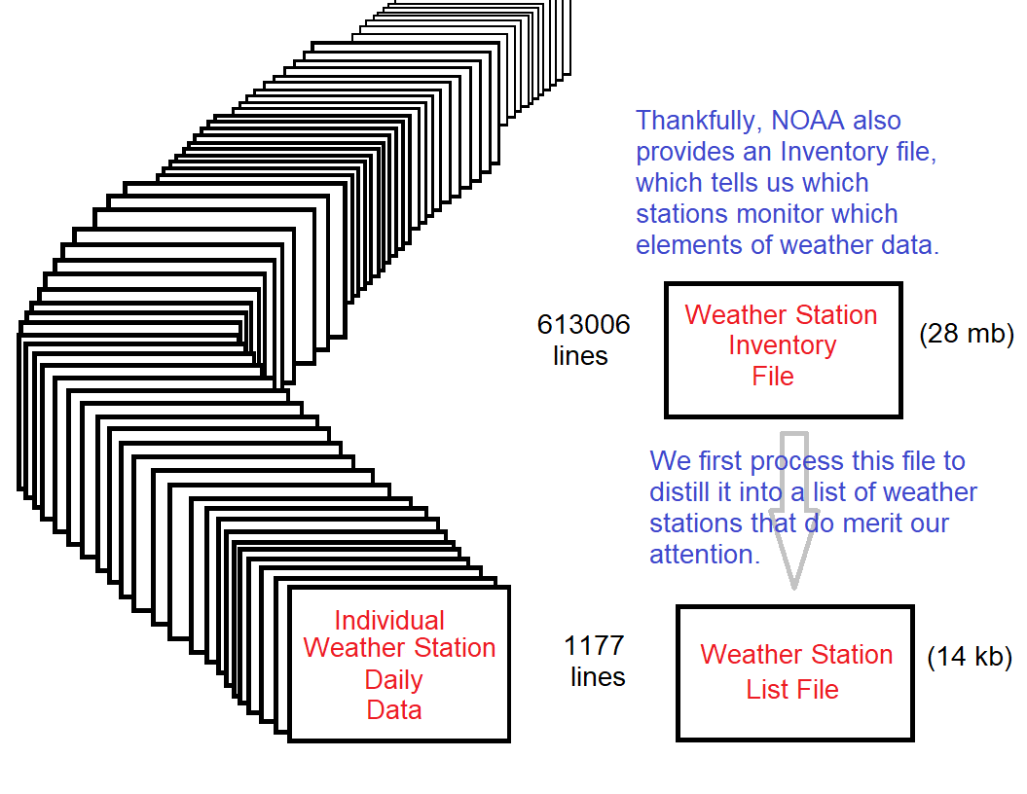
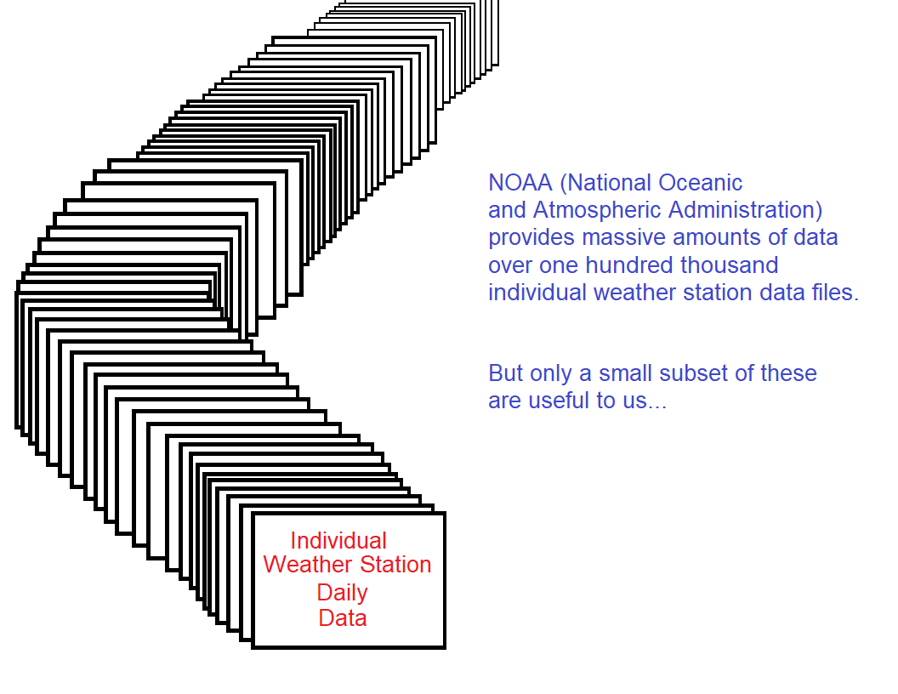
Data gathering and cleaning

Slide 5
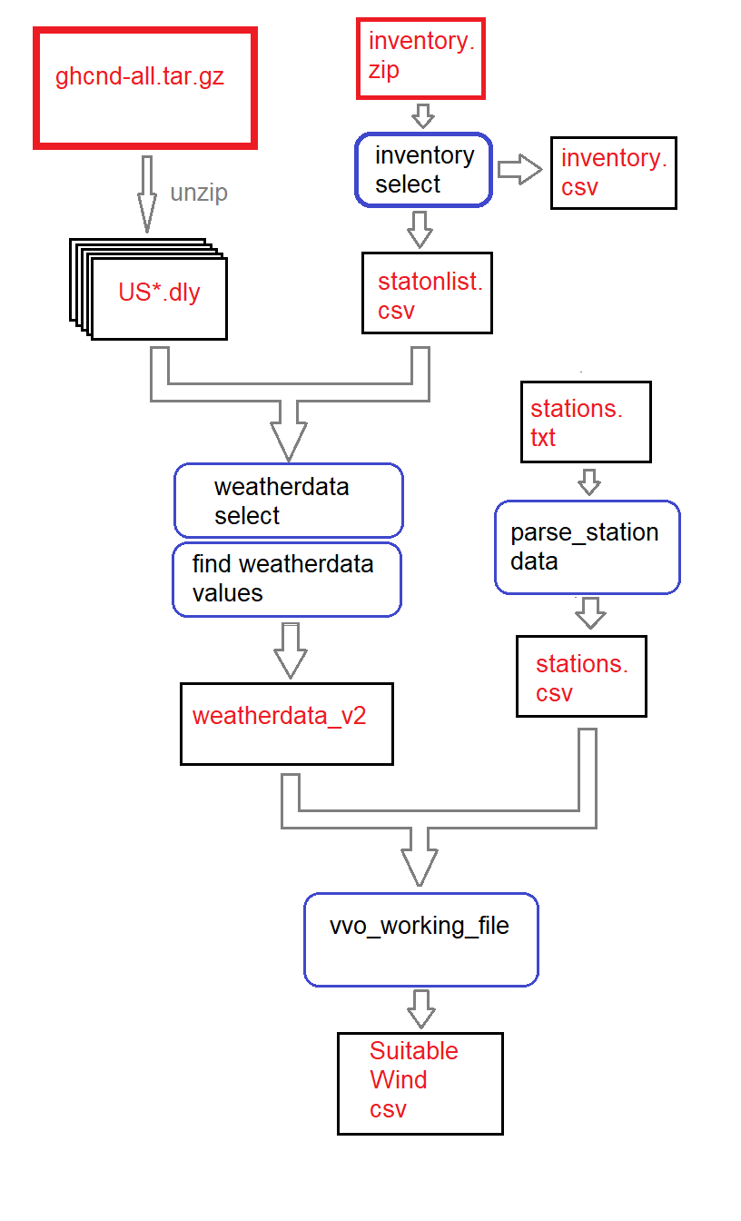
Data Flow

Slide 6
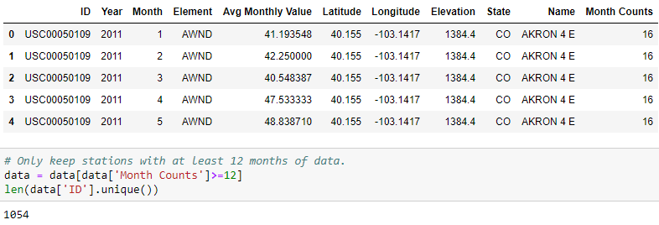
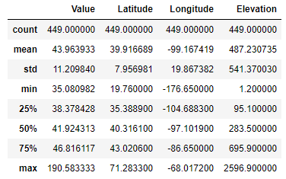
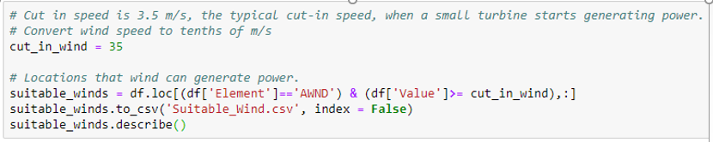
Requirements for wind farms.
8 kph (2 m/s) minimum is required to start rotating most small wind turbines.
12.6 kph (3.5 m/s) is the typical cut-in speed, when a small turbine starts generating power.
36–54 kph (10–15 m/s) produces maximum generation power.

Slide 7
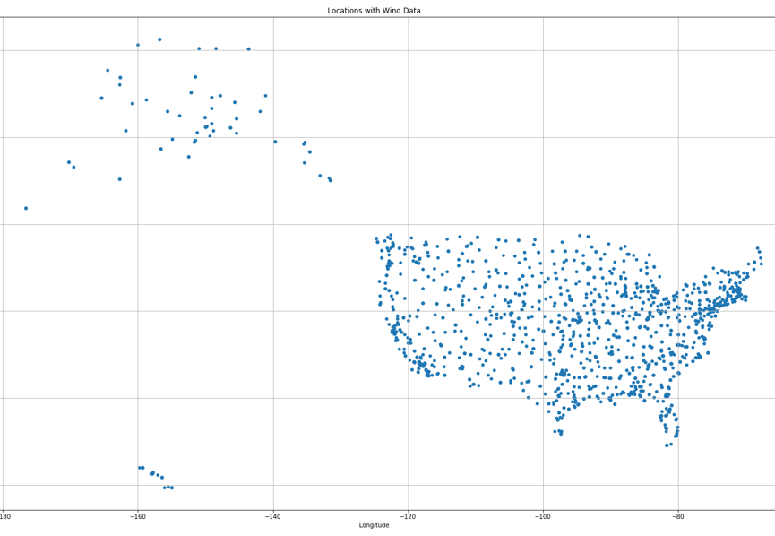
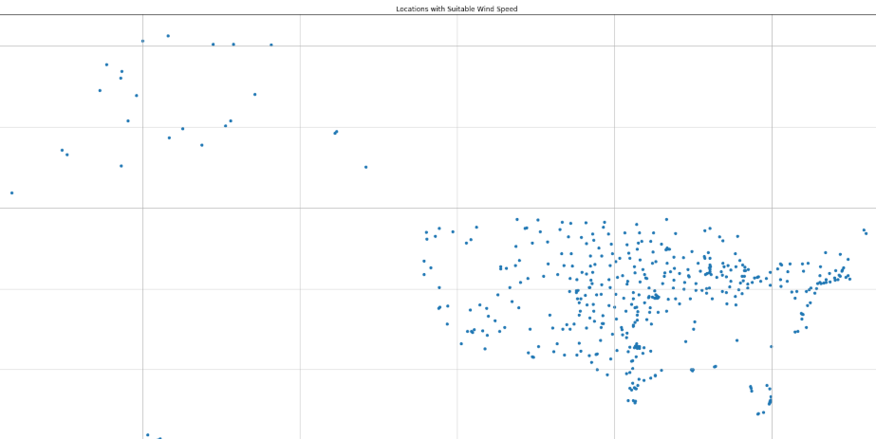
U.s. locations with wind data
U.s. locations suitable wind speed
1054
12.6 kph (3.5 m/s) is the typical cut-in speed, when a small turbine starts generating power.
449

Slide 8
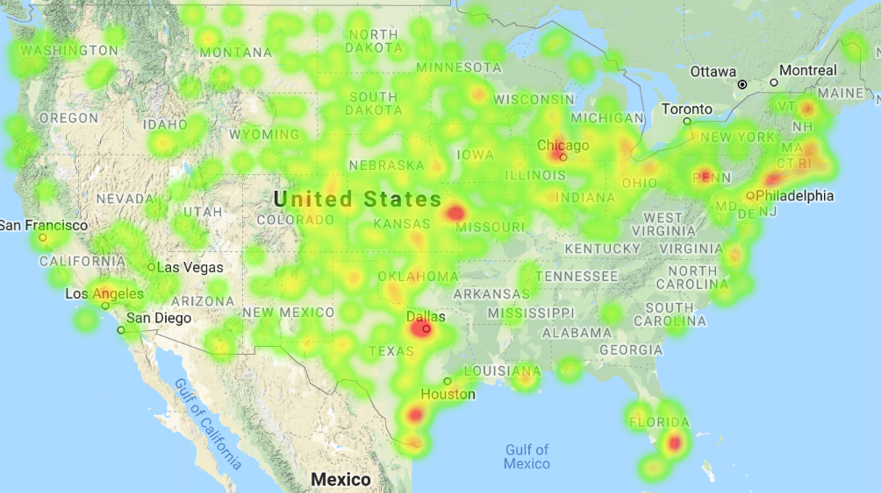
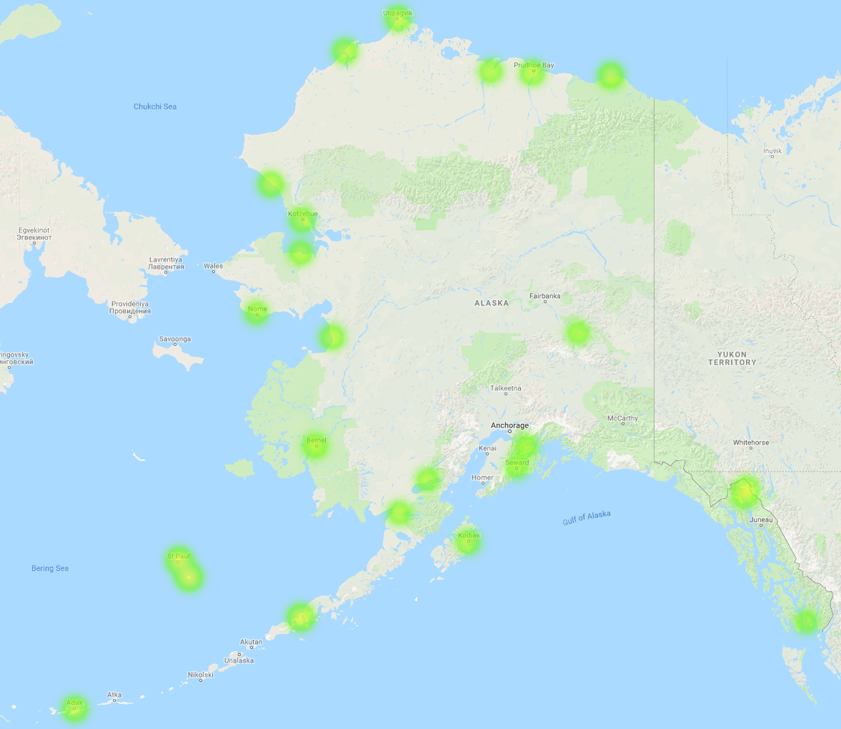
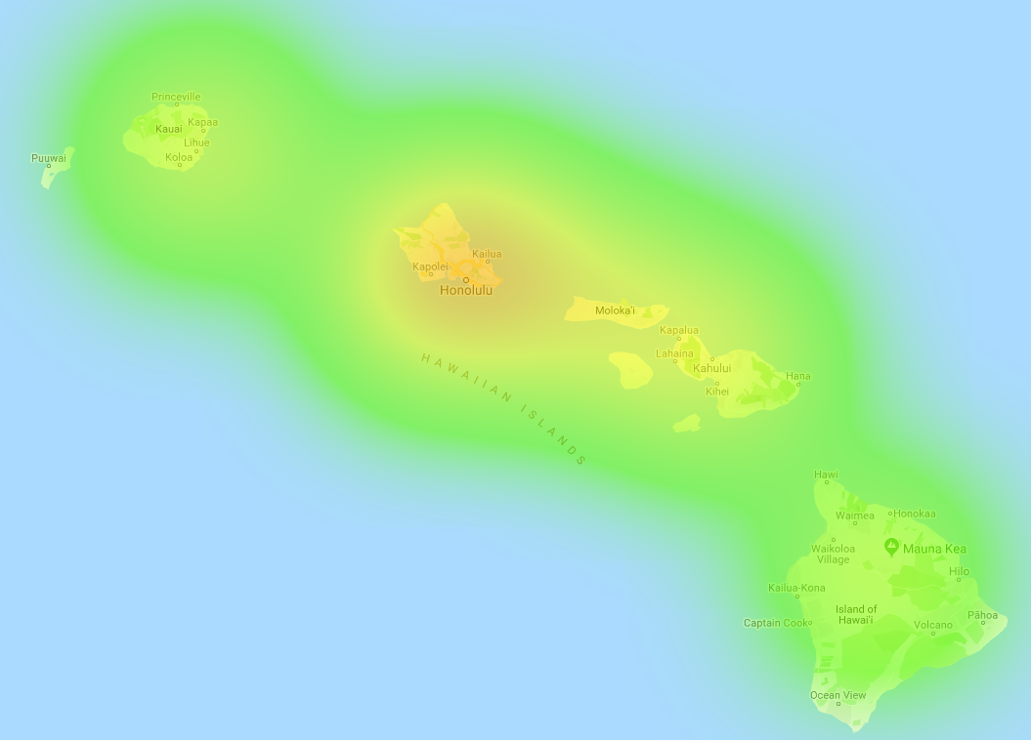
Suitable locations for wind farms?

Slide 9
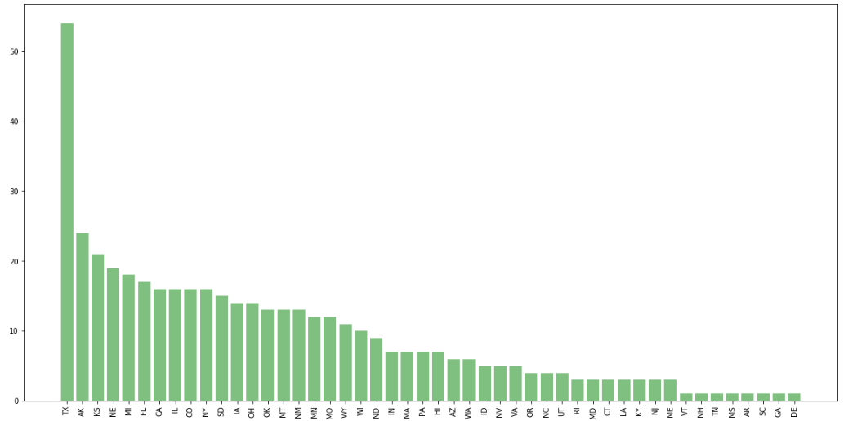
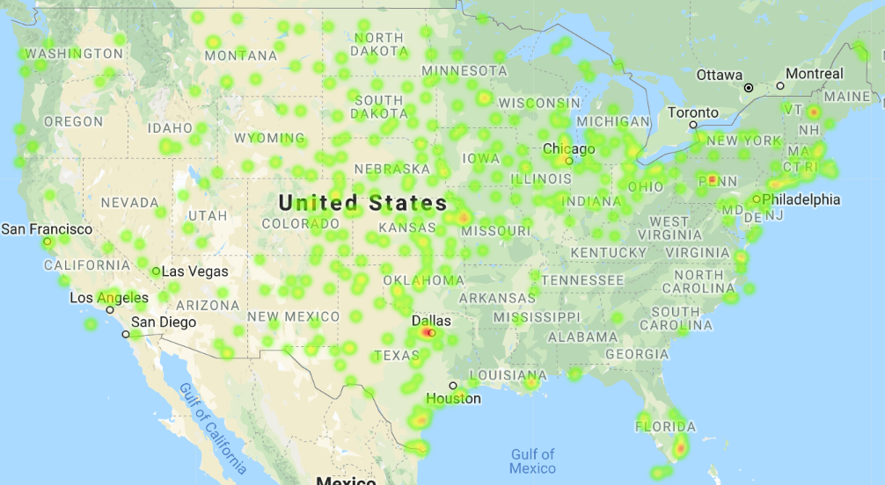
List of States with suitable wind speed

Slide 10
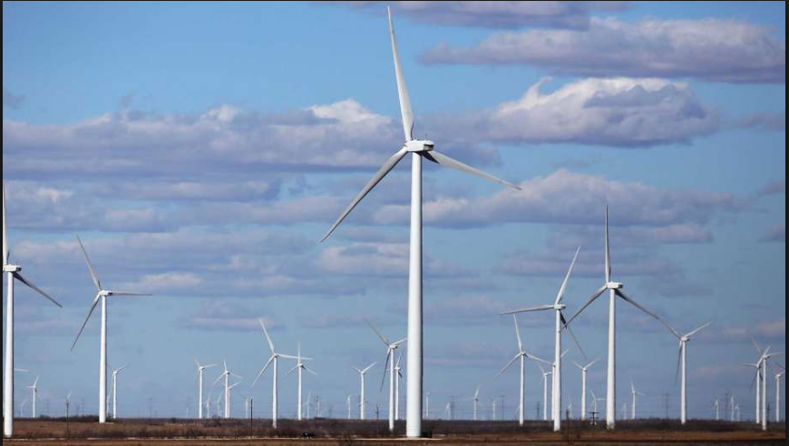
Where to build wind farm?
Considerations
* Human impact (population density)
* Local environmental impact
Local economic impact
* Power grid network
etc.

Slide 11
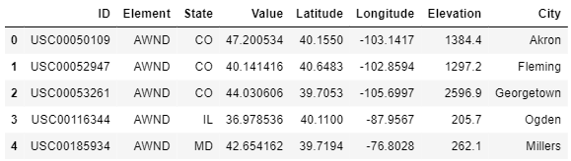
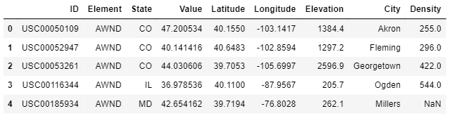
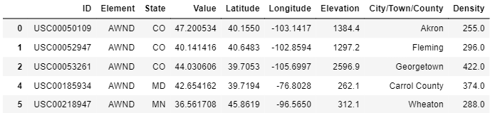
Population Density of 449 Locations
Lat/Lng of 449 Sites
Google Map API
Name of nearest cities
United States
Cities Database
Population Density of 449 locations (yr 2016)
Population density
<=500 per square mile
Narrow down to 161 locations

Slide 12
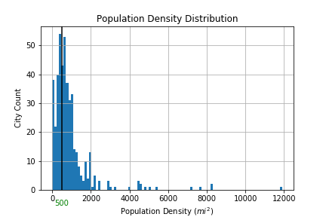
1/3 of 449 Locations meet the criteria

Slide 13
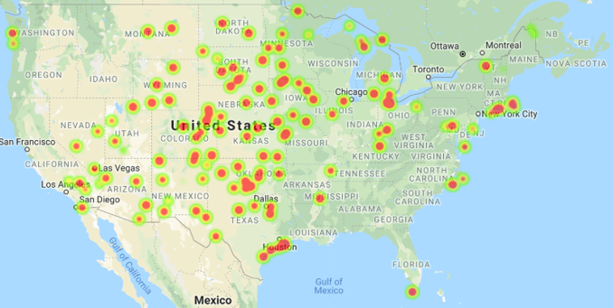
Locations with Population Density <= 500
449
161
Population Density <= 500

Slide 14
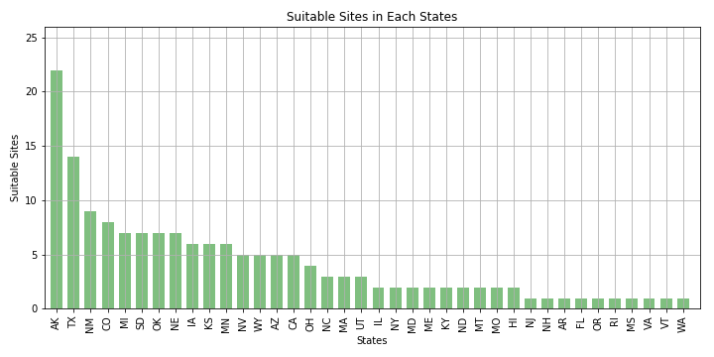
Suitable site counts for each state

Slide 15

Wind Turbine Locations with Climate and Health Benefits
A wind turbine in West Virginia displaces twice as much carbon dioxide and seven times as much health damage as the same turbine in California.”” Kyle Siler-Evans, Ph.D. researcher from Carnegie Mellon University .

Slide 16
Consumption in Each State in Year 2014
Dataset : United States Energy, Census, and GDP 2010-2014.csv
(the 2010-2014 US Energy, Census, and Economic data as described in the data set description, from U.S Energy Information Administration)
Here I only retrieve Coal total consumption for each state in 2014

Slide 17
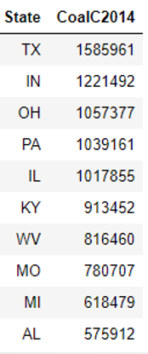
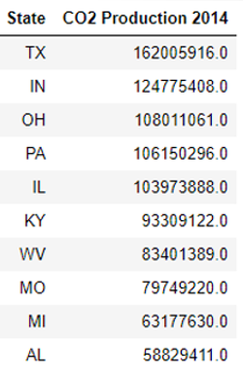
Coal total consumption
in billion BTU in 2014
Carbon Dioxide Production
Btu :British thermal units
Coal emits about 204.3 pounds of carbon dioxide per million Btu when completely burned.
2000 lb/ 1 tons
“CoalC2014” * 204300/2000 = “CO2 Production 2014(ton)”

Slide 18
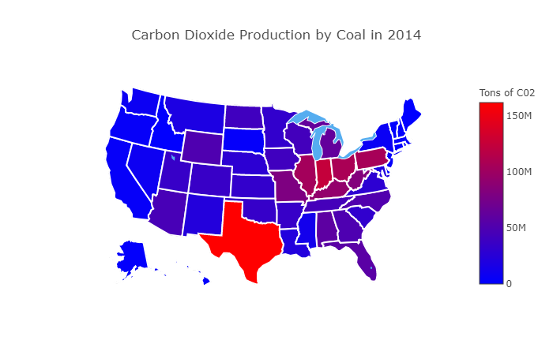

Slide 19
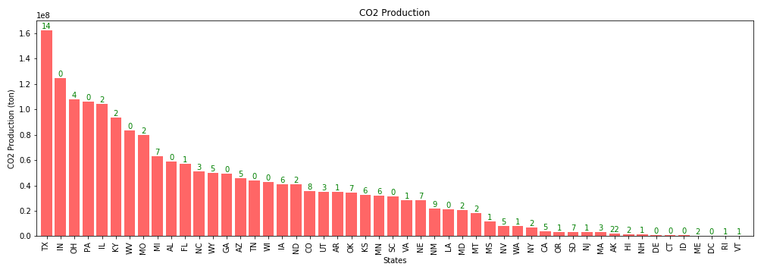
Combine Two Datasets
Wind farms result in greater health and climate benefits in states by replacing CO2 from big coal users such as Texas, Ohio, Illinois, Kentucky, and etc.

Slide 20
Conclusion
Texas can benefit greatly from wind energy: has the wind, has the land.
Data limitation

Slide 21
Question?

